Slide 1
RASS- A Concurrency Based Bitwise Symmetric Key Cryptographic Algorithm
Abhriya Roy, Ronit Ray, Saptarshi De, Shalini Guha, Sukalyan Goswami, Ratan Kumar Basak, Bipasha Mukhopadhyay, Souvik Chatterjee, Amrin Zaman, Sucheta Nag
Department of Computer Science and Engineering,
University of Engineering and Management, Kolkata, India
royabh314@gmail.com | ray.ronit@gmail.com | saptarshide2013@gmail.com | shaliniguha2@gmail.com | sukalyan.goswami@gmail.com | ratan.basak@uem.edu.in | bipasha.mukherjee@uem.edu.in | souvik.chatterjee@uem.edu.in | amrin.zaman03@gmail.com | suche1996@gmail.com

Slide 2
Contents
Abstract
Introduction
Objectives of Modern Cryptography
Background
Bitwise Ciphers
XOR function
One-Time Pad and Key Security
Types of Modern Cryptography
Common Symmetric Cryptography Algorithms
Concurrency, Parallelism, Multithreading
Previous Work
Proposed Algorithm
Key Generation
Encryption
Decryption
Performance Analysis and Comparison
Conclusion

Slide 3
Abstract
Features of the proposed algorithm :
Bit-level security
Linear time complexity
Robust security ( using two 16 bit keys )
Concurrency
Multithreading

Slide 4
Introduction
Cryptography is the science of secrets; an art of changing
plain, readable text messages to encrypted ciphertext which can
only be read by the intended receiver.
Key terms :
Plaintext
Ciphertext
Algorithms involved:
Encryption algorithm
Decryption algorithm
Secret Key

Slide 5
Introduction (Contd.)

Slide 6
Objectives of Modern Cryptography
Confidentiality:
Only an authorized person can access the information being communicated
A unique key is maintained between the sender and the receiver
Integrity:
The information cannot be manipulated or tampered with
Helps in constructing a secure channel for data communication
Non-repudiation:
One cannot deny his/her involvement in the creation of data or its transmission
Authentication:
The sender and receiver can be assured of the other’s identity and the origin/destination of the information

Slide 7
Background
Bitwise Ciphers
XOR function
One-Time Pad and Key Security
Types of Modern Cryptography
Common Symmetric Cryptography Algorithms
Concurrency, Parallelism, Multithreading

Slide 8
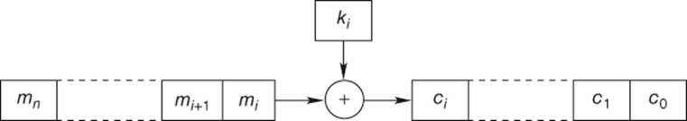
Background
Bitwise Cipher:
A bitwise cipher manipulates (performs an operation on) each bit of data sequentially instead of entire blocks.

Slide 9
Background (Contd.)
The XOR function/operation:
The XOR operator returns a 1/HIGH/TRUE whenever the inputs do not match, which occurs when one of the two inputs is exclusively true. This is the same as addition modulo 2.
Bitwise XOR (⊕)
OPERAND 1(OP1) | OPERAND 2(OP2) | RESULT= OP1 ⊕ OP2
0 | 0 | 0
0 | 1 | 1
1 | 0 | 1
1 | 1 | 0

Slide 10
The XOR function/operation (Contd.)
A unique property of XOR is that (A ⊕ B) ⊕ A returns B, because:
A ⊕ B ⊕ A
=> A ⊕ A ⊕ B (by commutative law)
=> (A ⊕ A) ⊕ B
0 ⊕ B
B
This is vital to the process of cryptography.
While this won’t give you the individual plaintexts, because XOR is not directly reversible, it still gives you a considerable amount of information about each of them.

Slide 11
Key Security And The One-Time Pad
One-Time Pad:
A randomly generated key of same length as plaintext is XORed with the plaintext, bit by bit.
Issues with One-Time Pad:
Same key could be generated twice
XORing of the two ciphertexts with the same could return considerable information about the two plaintexts for interceptor
C1 ⊕ C2 (P1 ⊕ K) ⊕ (P2 ⊕ K) (k is the same) P1 ⊕ K ⊕ P2 ⊕ K (removing parentheses) P1 ⊕ P2 ⊕ (K ⊕ K) (commutative law) P1 ⊕ P2 ⊕ 0 P1 ⊕ P2
Crib dragging: Guessing of the plaintext by passing small sequences along the ciphertext
Overhead increases due to the transmission of the huge key, so small keys are used instead

Slide 12
Types of Modern Cryptography
Secret Key Cryptography or Symmetric Cryptography
Encryption: Plaintext to ciphertext using a secret key
Decryption: Ciphertext to plaintext using verified key
Key Generator: A pseudo-random function generates the key to share
Public Key Cryptography or Asymmetric Cryptography
Asymmetric: Key information held by the sender and the receiver are dissimilar or asymmetric
Different Keys: One party has the secret key, other has the public key for decrypting it

Slide 13
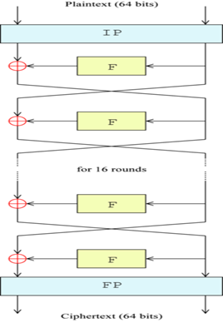
Some Symmetric Cryptographic Algorithms
DES(Data Encryption Standard)
DES (Data Encryption Standard) is a symmetric key 64-bit block cipher encryption algorithm developed by IBM.
Has an effective key size of 56 bits and another 8 bits is used for checking parity
Performs 16 rounds to encrypt data.
Disadvantage:
The small key size compared to other encryption algorithms made it vulnerable to various attacks, therefore making it insecure.

Slide 14
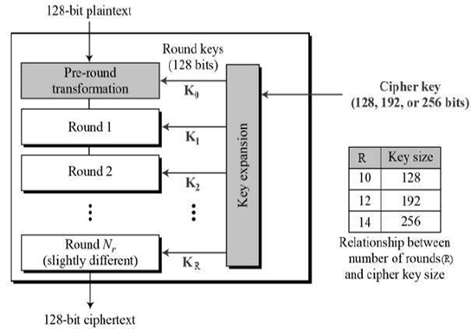
Some Symmetric Cryptographic Algorithms (Contd.)
AES (Advanced Encryption Standard):
Symmetric key 128 bit block cipher encryption algorithm.
Has variable key lengths of 128,192 and 256 bits.
Performs 10,12 and 14 rounds to encrypt 128,192 and 256 bits of data respectively.
Most effective and widely used encryption scheme.

Slide 15
Concurrency, Parallelism and Multithreading
Concurrency
Makes progress on more than one task at the same time
No concept of finishing one task before the next
Parallelism
Splitting of one task into several small sub-tasks which are then run parallely
Multithreading
Allows multiple flows of control to a processor
Implements concurrency
Each of these flows is called a thread
Increases the efficiency of the algorithm

Slide 16
Previous Work
Comparative research (see References)
K. Naveen Kumar et al
Bit-Level
Feistel-like approach
Bitwise shifts, logical XOR, addition-subtraction modulo 32
Satyaki Roy et al
Bit-Level
Randomized bits, feedback mechanism
Ashoke Nath et al
Bit-Level
Total inversion, bit manipulation at random prime locations, with bitwise shifts
Rajdeep Chakraborty et al
Bit-level
Desoky and Madhusudhan
Plaintext scrambling by division into 8 different planes and applying a separate key on each of the planes implementing a modified version of the Hill Cipher
Notes:
Here’s a look at the previous work conducted in this particular field.

Slide 17
Proposed Algorithm
Partitioning of plaintext into two parts.
A separate thread operates on each part concurrently.
Creation of two 16-bit keys.
Each key applied to a separate part of the plaintext
2^32 possible permutations over 2^16 for single key.
Scrambling by applying different schemes on different 16-bit blocks. Increases complexity.
Operation:
Linear (for even).
A crisscross (for odd).
First half of plaintext with second half of key and vice versa.
Notes:
These are the salient features of the algorithm proposed in our paper. *read out*

Slide 18
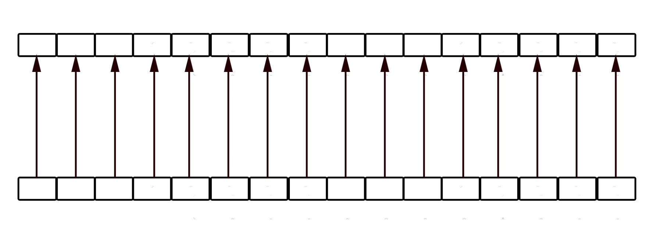
Linear XORing
Same pattern as One-Time Pad.
Each plaintext bit XORed with the corresponding key bit.
Notes:
Read out.

Slide 19
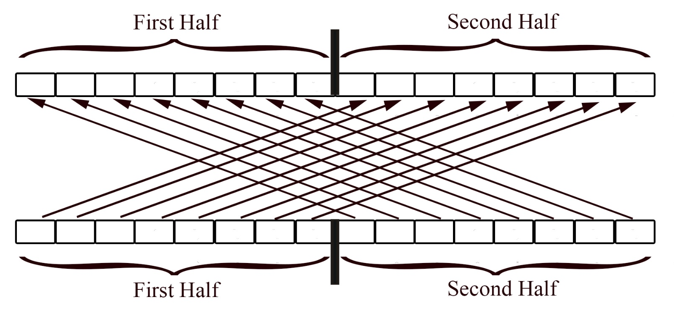
Criss-Cross XORing
Divide the 16-bit block into two 8-bit halves.
XOR the first half of plaintext with second half of key.
XOR the second half of plaintext with first half of key.
Notes:
Read out.

Slide 20
Algorithm: Key Generation
PROCEDURE GenerateKey(length)
START
STEP 1. SET key ← “”
STEP 2. for all i between 0 and length -1
STEP 3. num ← random floating-point no. between 0 & 1
STEP 4. IF (num > 0.5)
THEN key ← key+ ‘1’
ELSE
key ← key + ‘0’
STEP 5. Return key
STOP.
Notes:
This is the process of generating a randomized key of variable length.

Slide 21
Algorithm: XOR Methods
PROCEDURE EVEN(Text, Key)
//both params are 16 bits in length
START
STEP 1. SET encrypted ← “”
STEP 2. for all i in Text
STEP 3. encrypted+= Text[i] ⊕ Key[i]
STOP.
PROCEDURE ODD(Text,Key)
//both params are 16 bits in length
START
STEP 1. SET encrypted ← “”
STEP 1. for all i in Text
//crisscross done below
STEP 2. if(0<i<8)
STEP 3. encrypted+= Text[i] ⊕ Key[i+8]
else if(8<=i<16)
STEP 4. encrypted+= Text[i] ⊕ Key[i-8]
STOP.
Notes:
These are the different methods we will use to manipulate and encrypt the data.

Slide 22
Algorithm: Encryption
INPUT: Plaintext, Key1, Key2
OUTPUT: Ciphertext (same length as plaintext)
BEFORE EXECUTION: Build plaintext blocks of 16-bit width each.
START
STEP 1. SET half ← length_of_plaintext/2
STEP 2. for all i in BLOCKS
STEP 3. If (0<i<half)
STEP 4. If (i is EVEN) THEN
STEP 5. ciphertext+=EVEN(BLOCKS[i] , Key1)
else
STEP 6. ciphertext+=ODD(BLOCKS[i] , Key1)
else
STEP 7. If (i is EVEN) THEN
STEP 8. ciphertext+=EVEN(BLOCKS[i] , Key2)
else
STEP 9. ciphertext+=ODD(BLOCKS[i] , Key2)
STOP.
Notes:
Have a look at the encryption algorithm.

Slide 23
Algorithm: Decryption
INPUT: Ciphertext, Key1, Key2.
OUTPUT: Plaintext (same length as ciphertext)
BEFORE EXECUTION: Build ciphertext blocks of 16-bit width each.
START
STEP 1. for all i in BLOCKS
STEP 2. If (0<i<half)
STEP 3. If (i is EVEN) THEN
STEP 4. ciphertext+=EVEN(BLOCKS[i] , Key1)
else
STEP 5. ciphertext+=ODD(BLOCKS[i] , Key1)
else
STEP 6. If (i is EVEN) THEN
STEP 7. ciphertext+=EVEN(BLOCKS[i] , Key2)
else
STEP 8. ciphertext+=ODD(BLOCKS[i] , Key2)
STOP.
Notes:
Here is the decryption algorithm.

Slide 24
Performance Analysis and Comparison
The proposed algorithm is a bitwise cipher or “bit cipher”
it is unlike any of the block cipher standards like AES, DES or Blowfish, and is hence incomparable to any of them.
It can, however, be compared with the algorithm proposed by K. Naveen Kumar et al, which is also faster that Satyaki Roy et al.
Asoke Nath et al and Rajdeep Chakraborty et al failed to provide execution times for their proposed bit-level cryptographic algorithms and hence were not admissible to the comparison

Slide 25
Proposed v/s KN Kumar et al
Note: KN Kumar et al only provided data for files up to 2.25 KB in size.
File Size (KB) | Encryption Time (s) |  | Decryption Time (s)
 | Our Algorithm | K.N. Kumar et al | Our Algorithm | K.N. Kumar et al
0.25 | 0.0062 | 0.01 | 0.004 | 0.1
0.5 | 0.0091 | 0.16 | 0.003 | 0.19
0.75 | 0.0113 | 0.12 | 0.0027 | 0.13
1 | 0.0052 | 0.18 | 0.0035 | 0.19
1.25 | 0.0147 | 0.26 | 0.0028 | 0.2
1.5 | 0.0143 | 0.43 | 0.0061 | 0.32
2 | 0.0226 | 0.37 | 0.004 | 0.4
2.25 | 0.016 | 0.4 | 0.0086 | 0.38

Slide 26
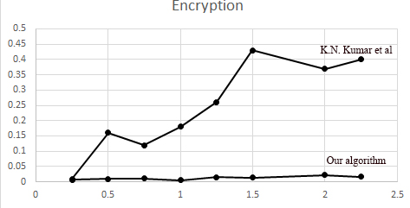
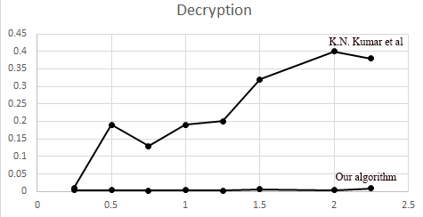
Trends
Time taken for growing data size

Slide 27
Further Trends
For data sizes up to 1MB.
File Size (KB) | Encryption Time (s) | Decryption Time (s)
5 | 0.102 | 0.019
10 | 0.164 | 0.044
50 | 0.869 | 0.401
100 | 1.238 | 1.235
250 | 7.807 | 7.73
500 | 34.682 | 35.431
750 | 90.087 | 88.839
900 | 139.87 | 138.14
1024 | 183.516 | 178.923

Slide 28
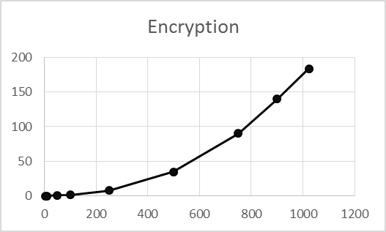
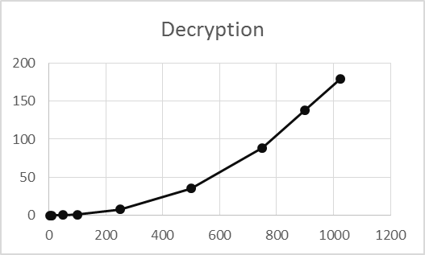
Growth Rate
All background CPU processes aside, the general nature of the graph’s growth rate is linear, or O(n), which is in keeping with the algorithm defined previously.

Slide 29
Conclusion
In this paper, we have proposed a symmetric key cryptographic algorithm with the following features:
Two 16-bit keys for reinforced security, working on two separate parts of the plaintext.
Two different encryption schemes for alternate blocks of text, thus increased unpredictability and improved security.
Concurrently working on two parts of plaintext at the same time, thus optimizing running time.
Providing security at the bit-level for assured security throughout the data life cycle.
The proposed algorithm performs significantly better than any similar proposed schemes in the past and has a linear growth rate.

Slide 30
Frequently Asked Questions
1. What language was the algorithm implemented in, and on what platform?
A. The algorithm was implemented in Java 8 on Eclipse Mars. Code is available upon request.
All tests were performed on a system with an Intel i7-3520M 2.93 GHz processor and 8 GB RAM.
Why is the proposed algorithm incomparable with AES, DES and Blowfish?
A. The three algorithms mentioned are all block ciphers, meaning they provide security at block-level. The proposed algorithm is a bitwise or bit- level cipher, which manipulates each individual bit of data and is hence secure down to every bit. This obviously is a different paradigm and is much slower, and hence should not be compared to block ciphers.

Slide 31
References
[1] Vivek Kaushik, Vikram Singh, Manish Vats, “Data Encryption Techniques for Dependable and Secure Cloud Computing”, 2014 IJIRT, Volume 1 Issue 6.
[2] Laurens Van Houtven, Crypto 101, II. Building Blocks, Exclusive OR
[3] Mihir Bellare, Phillip Rogaway, Introduction to Modern Cryptography, Chapter 4, Symmetric Encryption
[4] Piotr Nienaltowski, “Practical Framework for contract-based concurrent object-oriented programming”
[5] K. Naveen Kumar, G.V.S. Raj Kumar, K.T. Praveen Kumar, P. Chandra Sekhar, "Bitwise Operations Based Encryption and Decryption", International Journal on Computer Science and Engineering (IJCSE), Vol 3 No. 1 Jan 2011
[6] S. Vidhya, K. Chitra, "Format Preserving Encryption using Feistel Cipher", International Conference on Research Trends in Computer Technologies(ICRTCT-2013), Proceedings published in International Journal of Computer Applications® (IJCA) (0975–8887)
[7] Murray Eisenberg, "Hill Ciphers and Modular Linear Algebra", November 3, 1999.
[8] Ahmed Desoky, Anju Panicker Madhusoodhan, “Bitwise Hill Crypto System”, 2011 IEEE International Symposium on Signal Processing and Information Technology (ISSPIT), pp. 080-085

Slide 32
References (contd.)
[9] Sourabh Chandra, Siddhartha Bhattacharya, Smita Paira, Sk Safikul Alam, “A Study and Analysis on Symmetric Cryptography”, 2014 International Conference on Science, Engineering and Management Research.
[10] Gurpreet Singh, Supriya, “A Study of Encryption Algorithms (RSA, DES, 3DES and AES) for Information Security”, International Journal of Computer Applications (0975-8887) Volume 67- No. 19, April 2013
[11] Sourabh Chandra, Smita Paira, Sk Safikul Alam, Goutam Sanyal, “A Comparative Survey of Symmetric and Asymmetric Key Cryptography”, 2014 International Conference on Electronics, Communication and Computational Engineering (ICECCE)
[12] Harsh Mathur, Zahid Alam, “Analysis in Symmetric and Asymmetric Cryptology Algorithm”, International Journal of Emerging Trends & Technology in Computer Science (IJETTCS), Volume 4, Issue 1, January-February 2015
[13] Satyaki Roy, Shalabh Agarwal, Asoke Nath, Navajit Maitra, Joyshree Nath, "Ultra Encryption Algorithm (UEA): Bit Level Symmetric key Cryptosystem with Randomized Bits and Feedback Mechanism, International Journal of Computer Applications (0975-8887) Volume 49- No.5, July 2012
[14] Asoke Nath, Madhumita Santra, Supriya Maji, Kanij Fatema Aleya, "Bit Level Symmetric Key Encryption Algorithm (BLSKEA-1) Version-1", International Journal of Innovative Research in Computer and Communication Engineering, Vol. 3 Issue 11, November 2015
[15] Rajdeep Chakraborty, Sonam Agarwal, Sridipta Misra, Vineet Khemka, Sunit Kr Agarwal, JK Mandal, "Triple SV: A Bit Level Symmetric Block Cipher Having High Avalanche Effect", (IJACSA) International Journal of Advanced Computer Science and Applications, Vol. 2, No.7, 2011

